Slide 2
My current under-standing of NequIP

Slide 3
Work in progress
I do not complete understanding of the network (so may be more of a discussion)
Currently I am looking into Group theory

Slide 4
Outline
Constructing the input graph
Layers of NequIP (data flow)
Output of NequIP

Slide 5
Constructing graph
Starting with an ensemble of atoms (a point cloud).

Slide 6

Constructing graph
Starting with an ensemble of atoms (a point cloud).
Atomic neighbors are selected based on a maximum radius.
$$r_{max}$$

Slide 7
Constructing graph
Starting with an ensemble of atoms (a point cloud).
Atomic neighbors are selected based on a maximum radius.
The neighbors are then connected via an edge.
$$r_{max}$$

Slide 8
Constructing graph
Starting with an ensemble of atoms (a point cloud).
Atomic neighbors are selected based on a maximum radius.
The neighbors are then connected via an edge.
Repeating for each atom yields the graph.

Slide 9
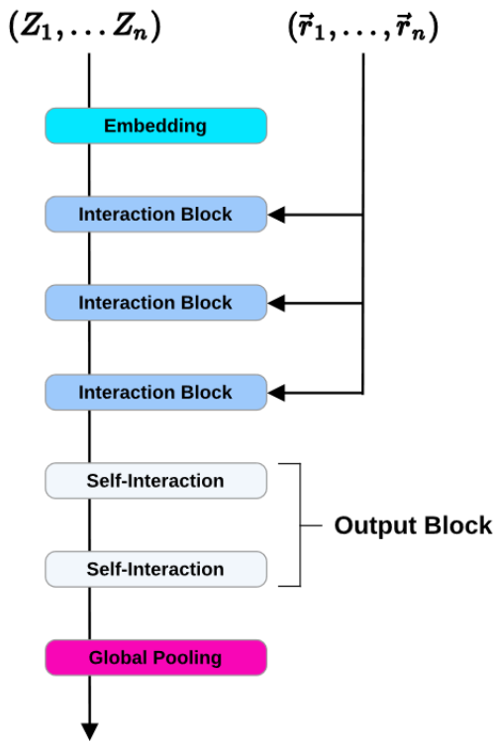
Input to NequIP

Slide 10
Input to NequIP
The input is the graph nodes and edges.

Slide 11
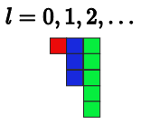

Input to NequIP
One hot encoding (atomic species) → Trainable embedding.
E.g., two different atoms like H and C will yield two different embeddings.
$$W$$

Slide 12
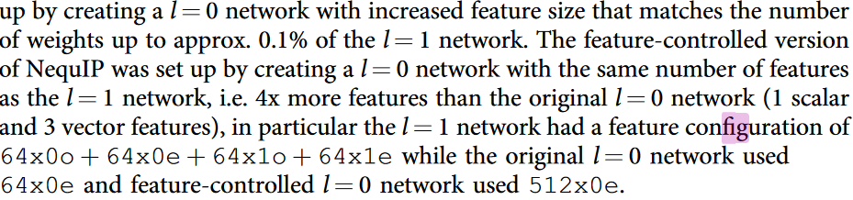
Input to NequIP
One hot encoding (atomic species) → Trainable embedding.
E.g., two different atoms like H and C will yield two different embeddings.
The nummer and types of elements in the embedding is a hyperparameter.
Example:
$$W$$

Slide 13
Input to NequIP
One hot encoding (atomic species) → Trainable embedding.
E.g., two different atoms like H and C will yield two different embeddings.
The nummer and types of elements in the embedding is a hyperparameter.
Example:
$$W$$
Odd parity
Even parity
Odd-
Even-
2 x 64 x Scalars
2 x 64 x Vectors

Slide 14
Input to NequIP
One hot encoding (atomic species) → Trainable embedding.
E.g., two different atoms like H and C will yield two different embeddings.
The nummer and types of elements in the embedding is a hyperparameter.
Example:
$$W$$
Odd parity
Even parity
Odd-
Even-
2 x 64 x Scalars
2 x 64 x Vectors

Slide 15
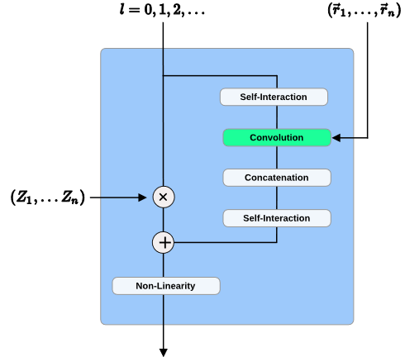
Interaction Block

Slide 16


Interaction Block
Self-Interaction: Mixes together features with the same rotation order and parity pair ($l_{o},p_{o}$) are mixed by linear atoms-wise self-interaction layers:
Here $l$ is the iteration and $i$ the atom index.

Slide 17
Interaction Block
Self-Interaction: Mixes together features with the same rotation order and parity pair ($l_{o},p_{o}$) are mixed by linear atoms-wise self-interaction layers:
Here $l$ is the iteration and $i$ the atom index.

Slide 18
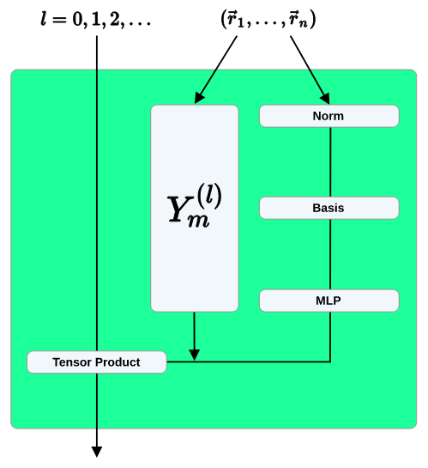


Convolution

Slide 19
Convolution

Slide 20




Convolution
Norm
Bessel function, with envelope polynomial $f_{env}$.

Slide 21

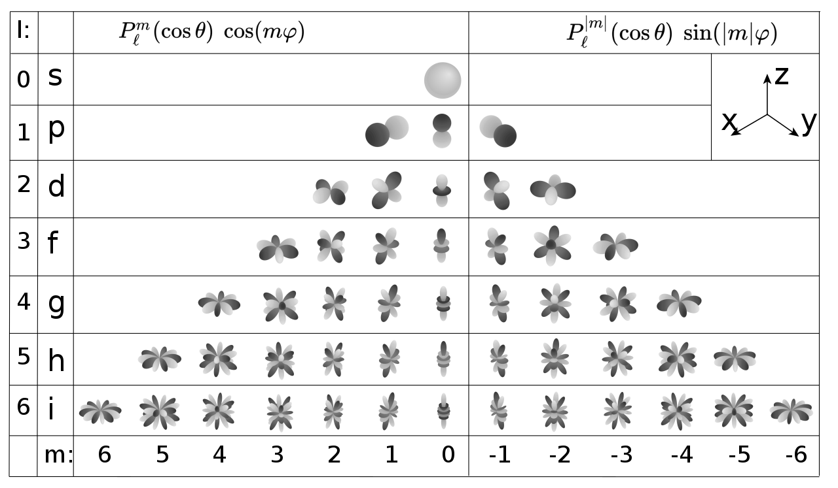

Convolution
Fixed $l_{f}$ but:

Slide 22
Convolution
For all neighbors

Slide 23
Convolution
Clebsch-Gordan coefficients …….

Slide 24


Convolution
Tensor product may yield:
We only keep:

Slide 25
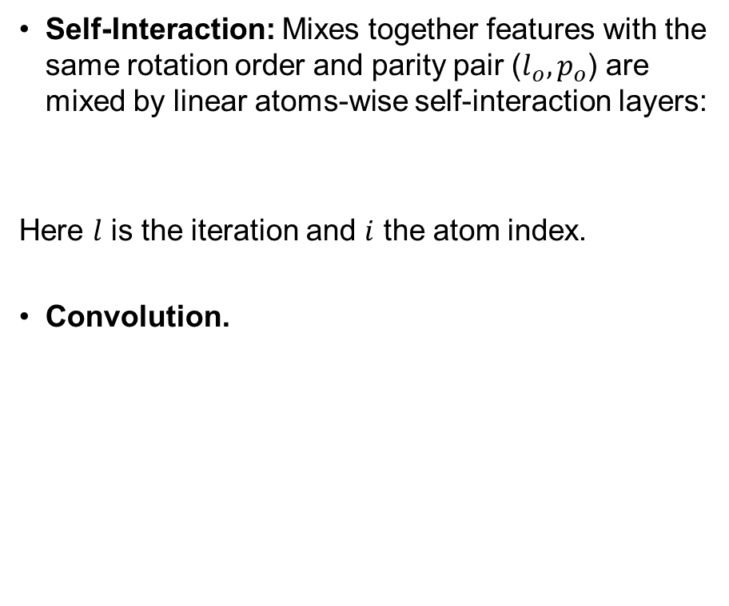
Interaction Block
Self-Interaction: Mixes together features with the same rotation order and parity pair ($l_{o},p_{o}$) are mixed by linear atoms-wise self-interaction layers:
Here $l$ is the iteration and $i$ the atom index.
Convolution.

Slide 26
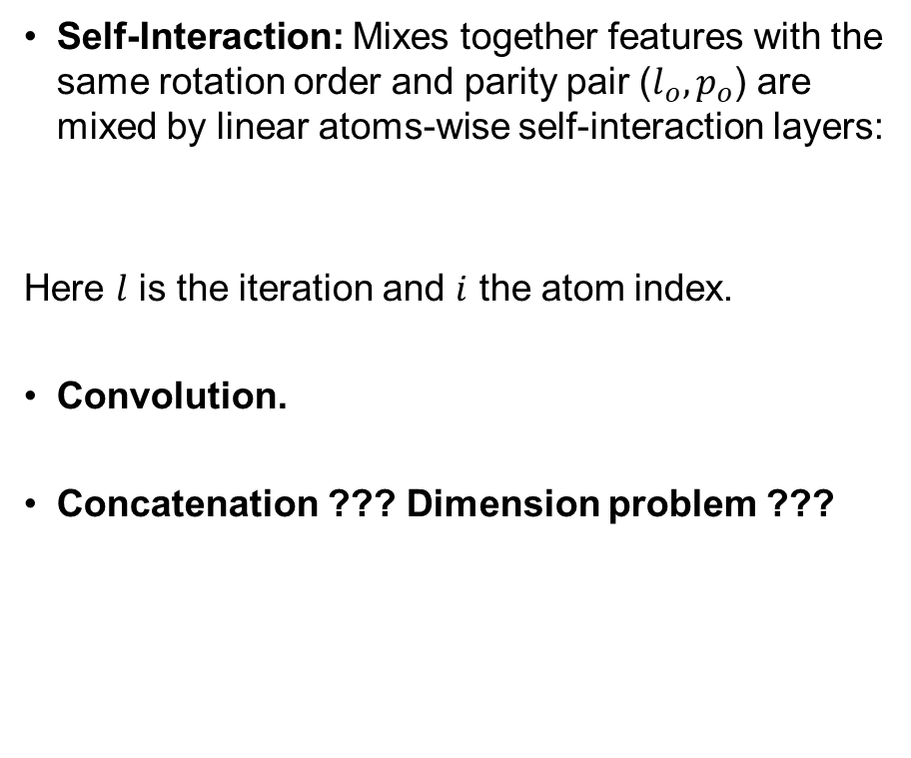
Interaction Block
Self-Interaction: Mixes together features with the same rotation order and parity pair ($l_{o},p_{o}$) are mixed by linear atoms-wise self-interaction layers:
Here $l$ is the iteration and $i$ the atom index.
Convolution.
Concatenation ??? Dimension problem ???

Slide 27
Interaction Block
Self-Interaction: Mixes together features with the same rotation order and parity pair ($l_{o},p_{o}$) are mixed by linear atoms-wise self-interaction layers:
Here $l$ is the iteration and $i$ the atom index.
Convolution.
Concatenation ??? Dimension problem ???

Slide 28
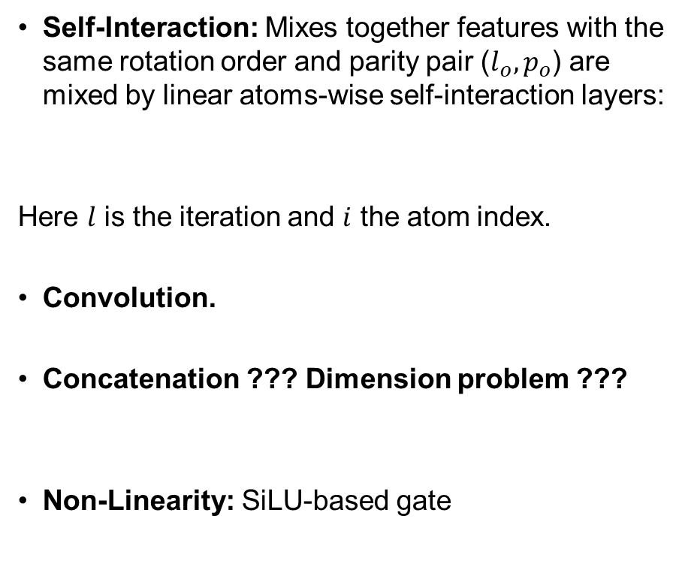
Interaction Block
Self-Interaction: Mixes together features with the same rotation order and parity pair ($l_{o},p_{o}$) are mixed by linear atoms-wise self-interaction layers:
Here $l$ is the iteration and $i$ the atom index.
Convolution.
Concatenation ??? Dimension problem ???
Non-Linearity: SiLU-based gate

Slide 29
Output block
Output Block: the features of the final convolution are passed to the output block, which is two atoms wise self-interaction layers.
From the convolution?

Slide 30

Final output
Global pooling layer
Trainable atom wise parameters

Slide 31
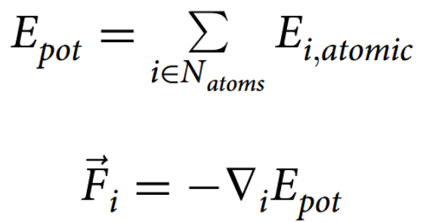
Final output
Global pooling layer
Trainable atom wise parameters

Slide 32
Final output
Global pooling layer
The “final” output of NequIP is the total potential energy.
From this is the forces on an atom found via the negative derivative.
Trainable atom wise parameters

Slide 33
The end

Slide 34
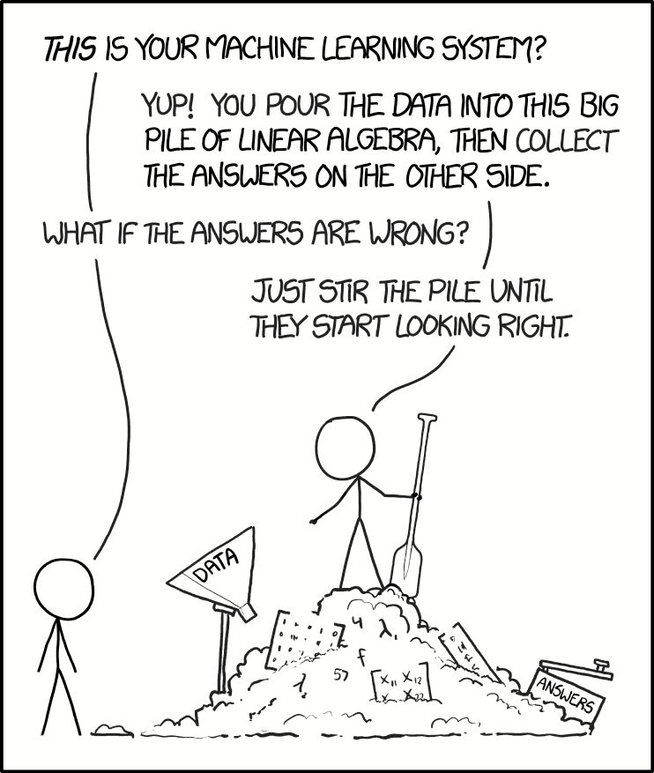

Slide 35
Convolution
Norm
TEMP

Slide 36
Titel
The end:
Forces are then obtained as the gra-
dients of this predicted total potential energy with respect to the
atomic positions (thereby guaranteeing energy conservation)

Slide 37
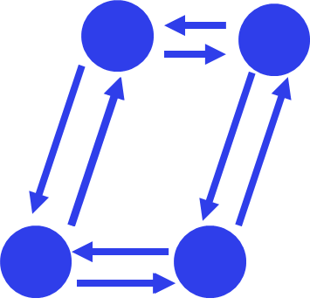
Titel
Input
The end:
Forces are then obtained as the gra-
dients of this predicted total potential energy with respect to the
atomic positions (thereby guaranteeing energy conservation)

